Slide 1

MINI PROJECT
BATCH 1:
Ishika Goenka- 121910319009
G.SUKSHITH-121910319007
Sridhar -121910319024
Vyshnavi-121910319033

Slide 2
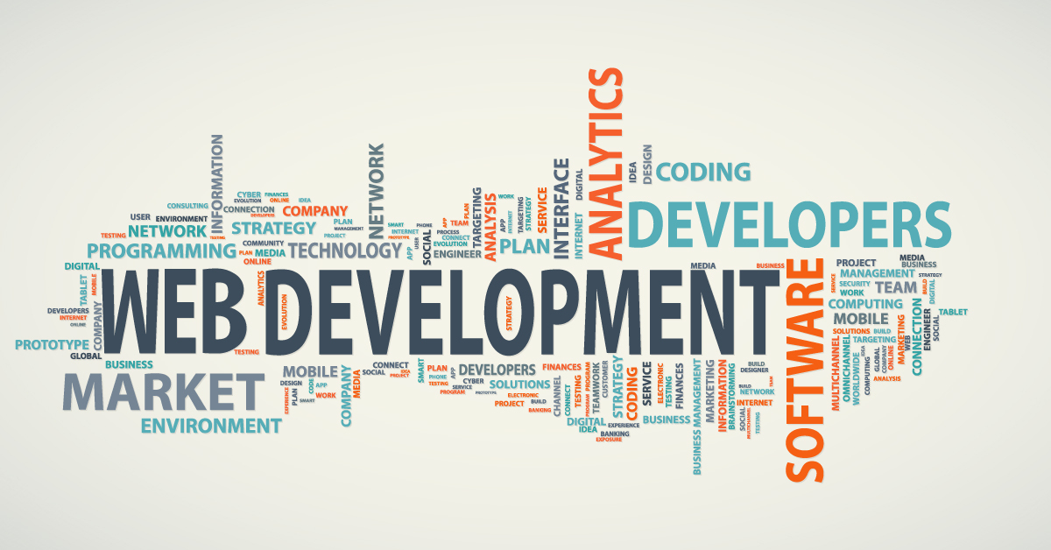
DOMAIN

Slide 3
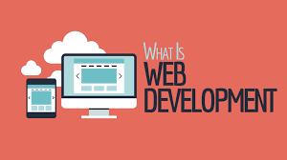
Web development is the work involved in developing a website for the Internet.
Web development can range from developing a simple single static page of plain text to complex web applications, electronic businesses and social network services.

Slide 4
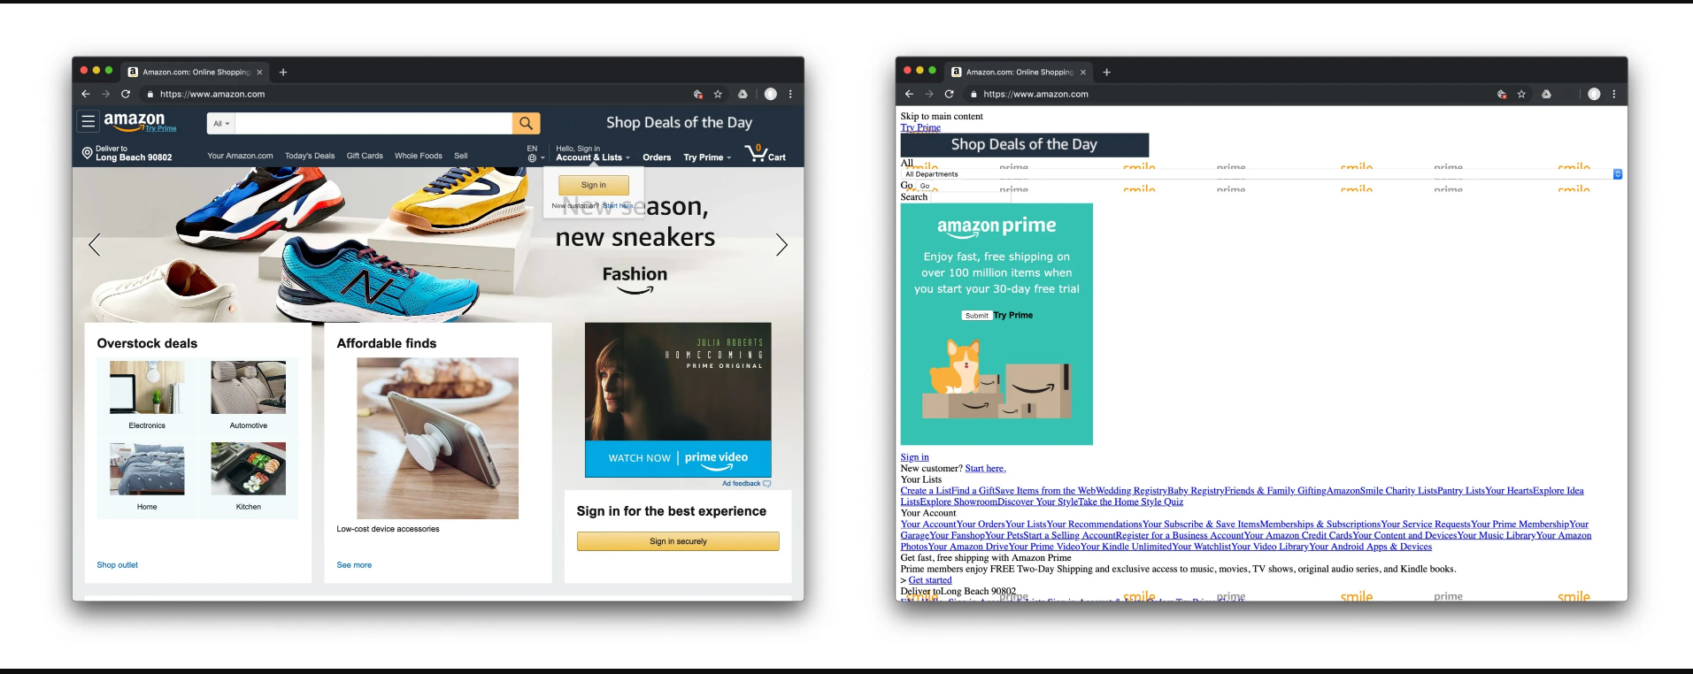
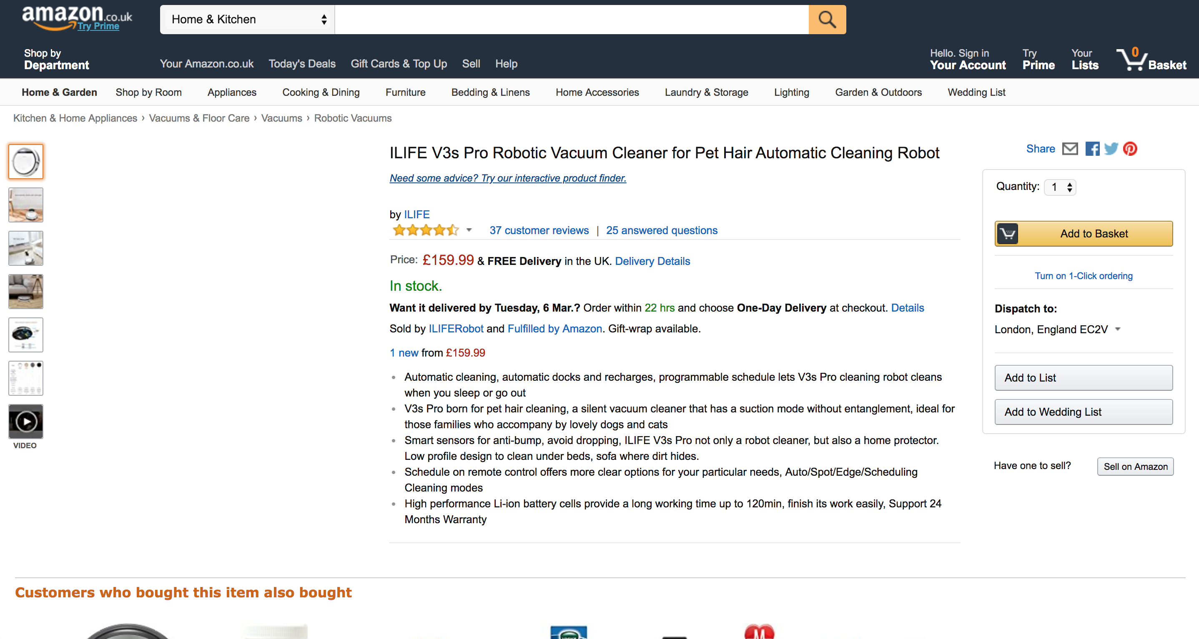

Slide 5
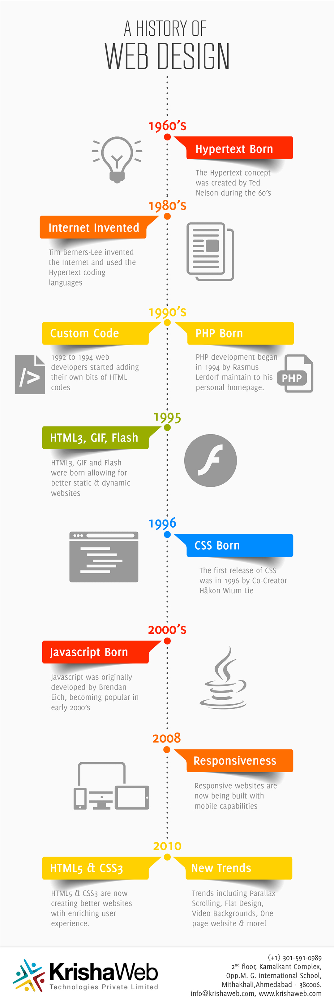
HISTORY OF WEB TECHNOLOGY

Slide 6
TYPES OF WEB DEVELOPMENT
There are three types of web development:-
Front end web development.
Back end web development.
Full Stack web development.

Slide 7
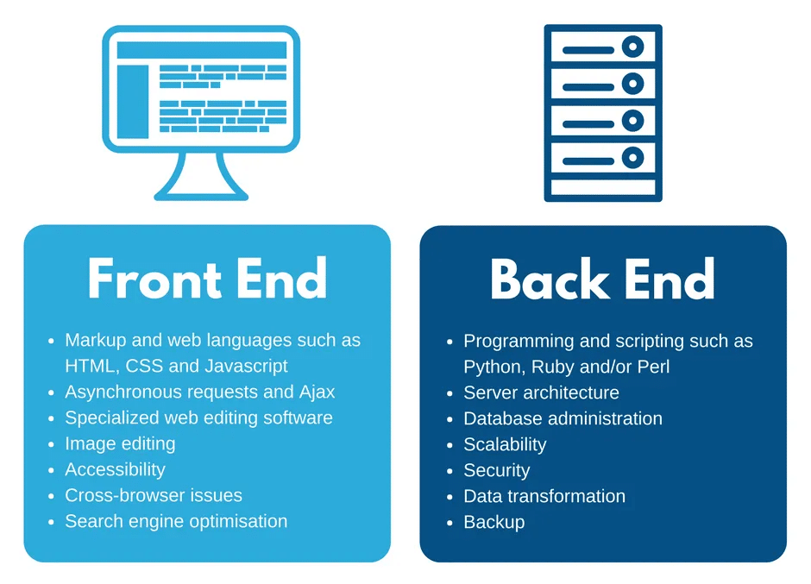

Slide 8
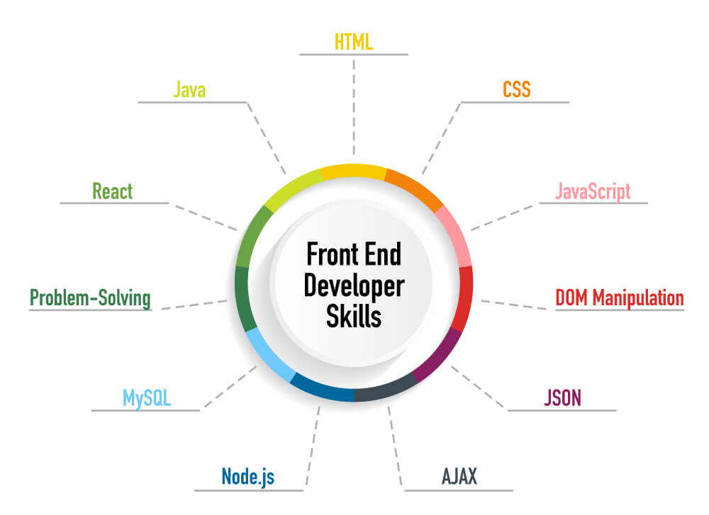

Slide 9
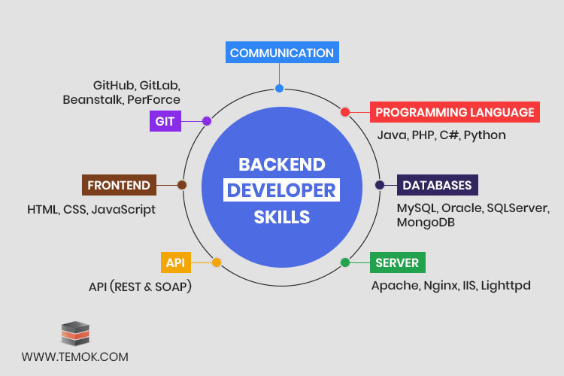

Slide 10
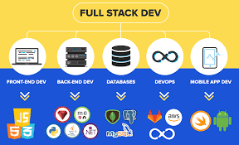
FULL STACK DEVELOPMENT
It refers to the development of both front end(client side) and back end(server side) portions of web application.
A full stack web developer is a person who can develop both client and server software.

Slide 11
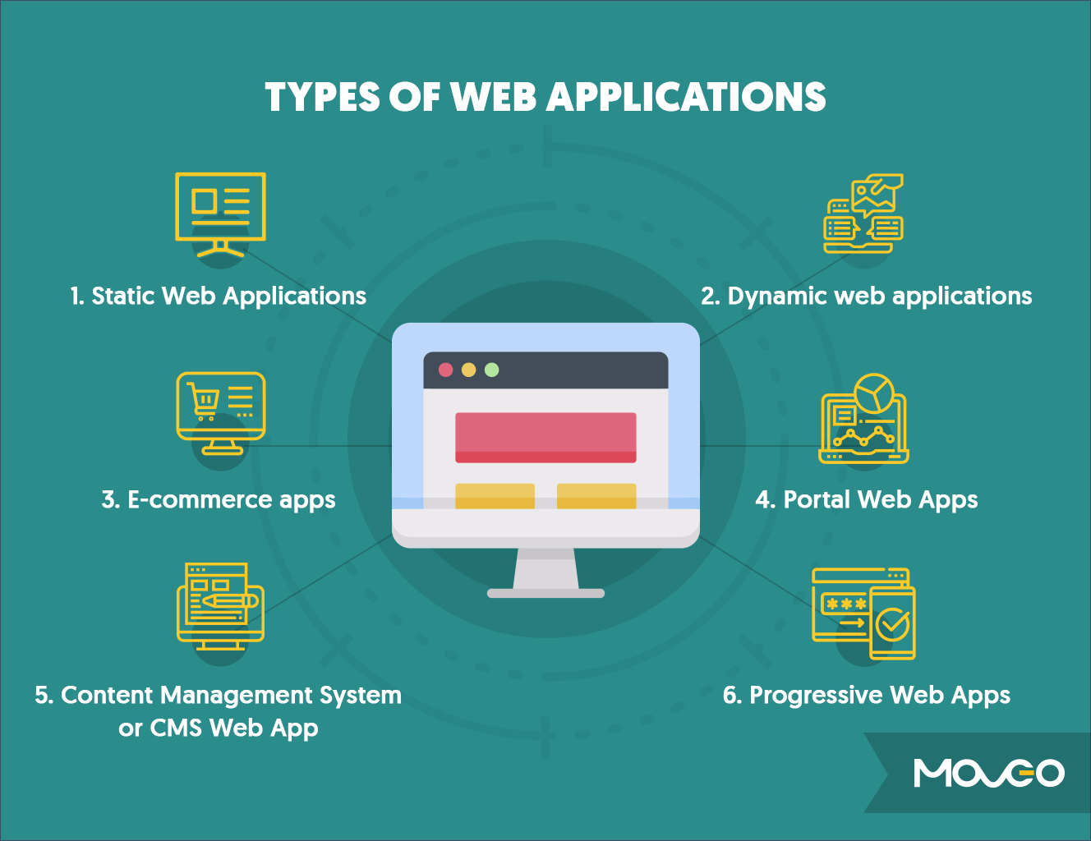

Slide 12
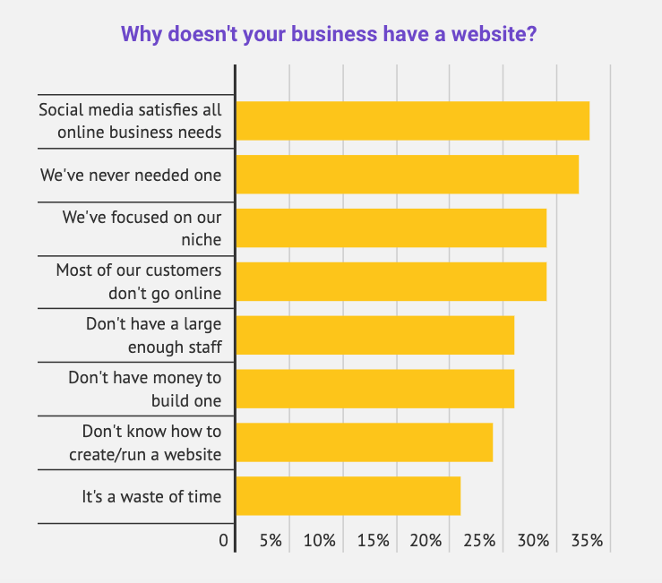
STATISTICS

Slide 13
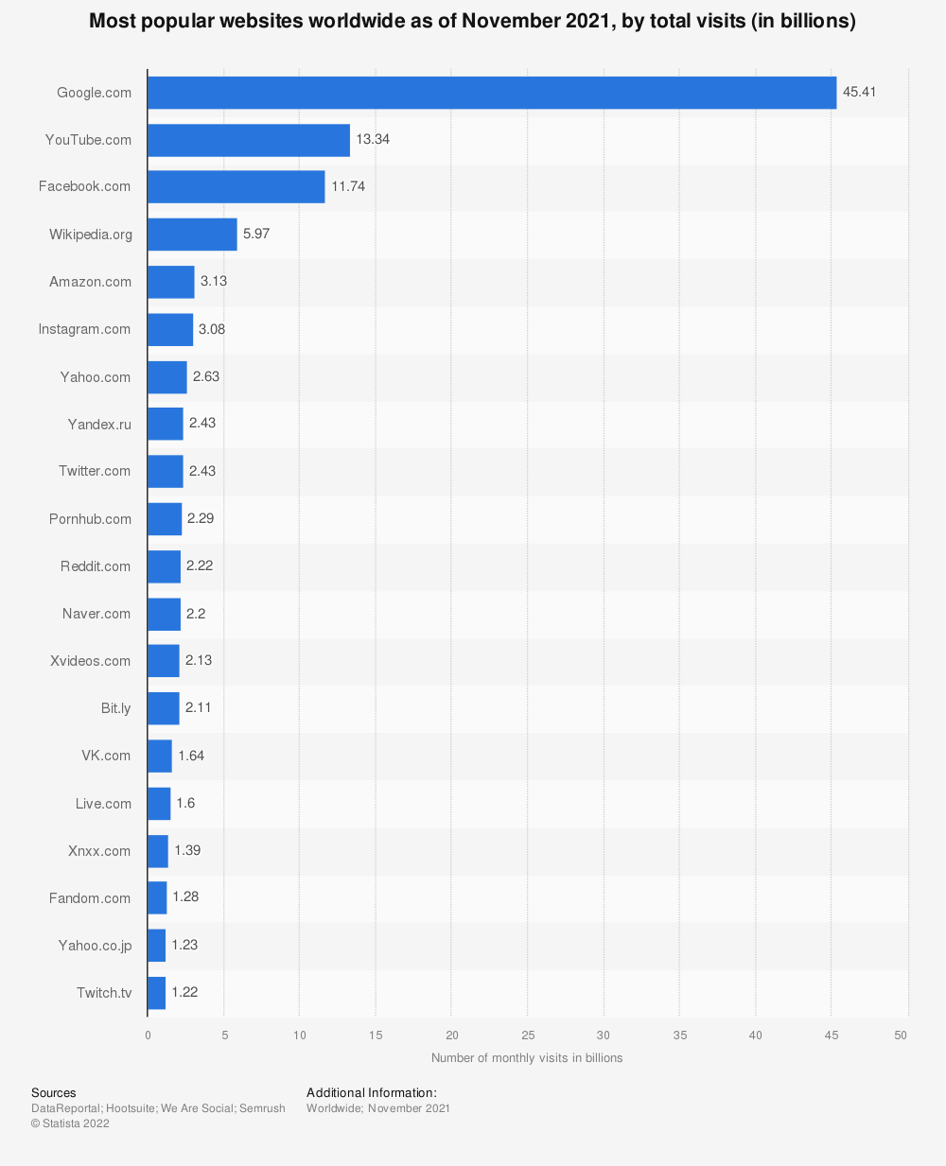

Slide 14
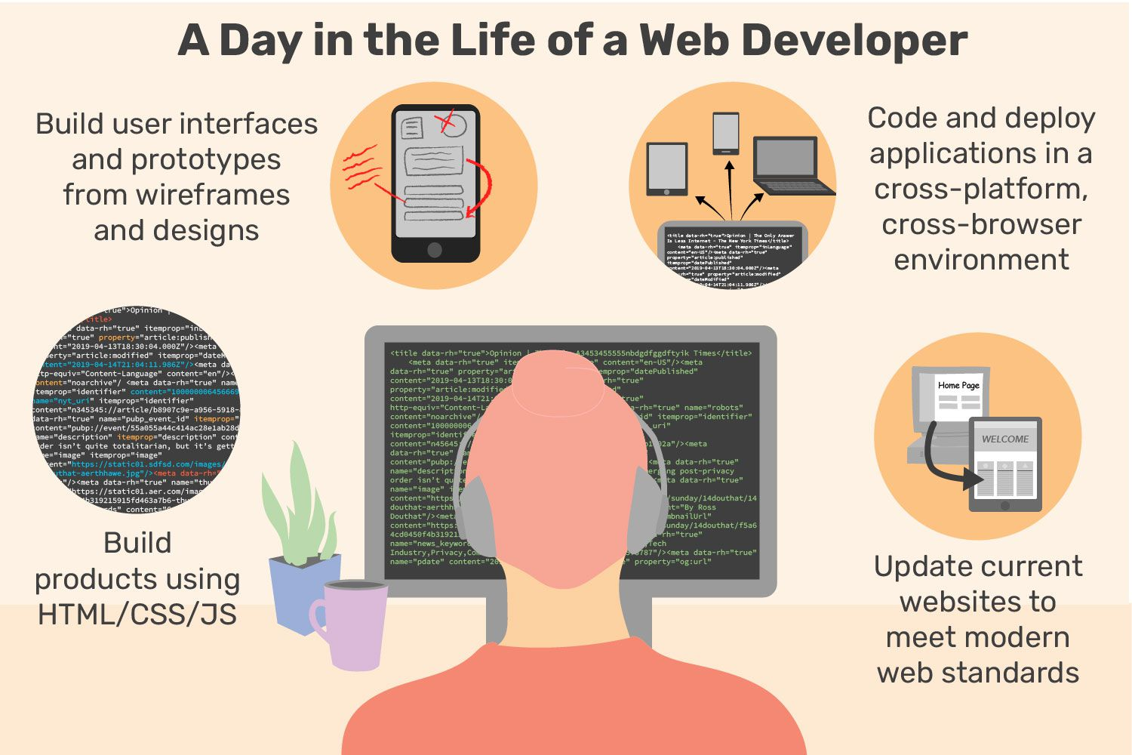
WEB DEVELOPER

Slide 15
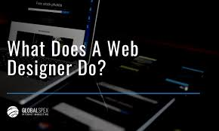
WEB DESIGNER
Web designers create the visual aspects of websites.
The aesthetic aspect is an important one and selecting the appropriate colors, font, layout and images creates the whole personality of the website.

Slide 16
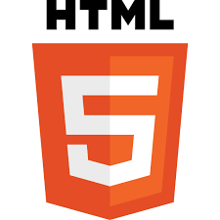


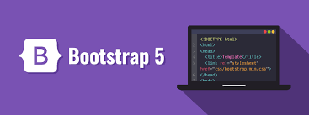



DOMAINS WE WOULD USE IN OUR PROJECT

Slide 17
HTML AND CSS
HTML
HTML stands for Hypertext Markup Language.
Used for describing the structure of Web pages.
HTML elements tell the browser how to display the content.
CSS
CSS stands for Cascading Style Sheets.
CSS describes how elements should be rendered on screen, on paper, in speech, or on other media.
It is used to style and layout web pages.

Slide 18
JavaScript and Bootstrap
JavaScript
JavaScript (JS) is a lightweight, interpreted, or just-in-time compiled programming language with first-class functions.
JavaScript is used by programmers across the world to create dynamic and interactive web content like applications and browsers.
Bootstrap
Bootstrap is a free and open source front end development framework for the creation of websites and web apps.
Bootstrap is a potent front-end framework used to create modern websites and web apps.

Slide 19
React JS , MySQL, php
React JS
React. js is an open-source JavaScript library that is used for building user interfaces specifically for single-page applications.
It's used for handling the view layer for web and mobile apps.
MYSQL
MySQL is an open source relational database management system.
It helps you store all your blog posts, users, plug-in information, etc..
Php
PHP is an open-source server-side scripting language that many devs use for web development.
It is used for creating GUI.

Slide 20


